Slide 1
ELEC 7080 Algo Trading and HFT
WONG Nga Yan Dorothy
Park Seo Hye, Sarah
Ho Kam Tim, Steven
Li Zhilin (Camille)
http://www.free-powerpoint-templates-design.com

Slide 2
Agenda
01
Introduction of the project
02
Pre-trade Analysis
03
Prediction Model
04
Long-short Strategy
05
Risk Management & Potential Improvement

Slide 3
Introduction of the project

Slide 4
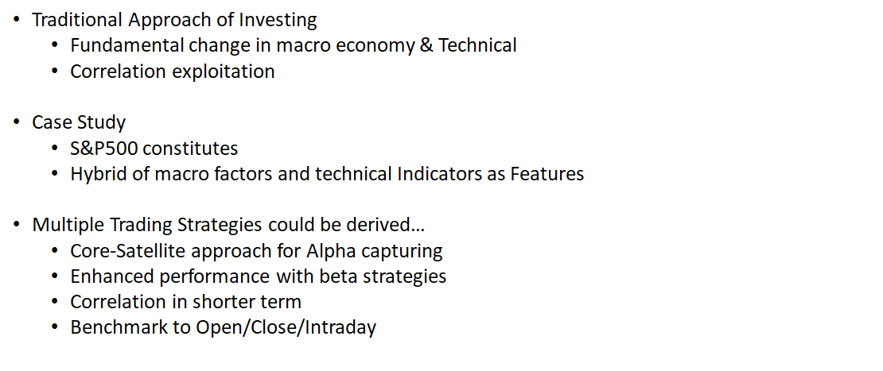
Introduction and Motivation of Research

Slide 5
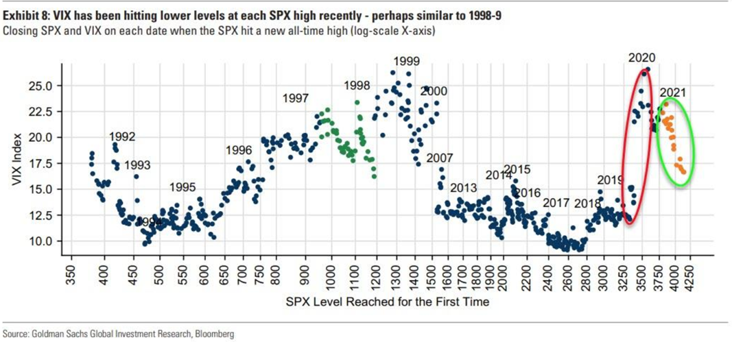
Feature Selection - VIX

Slide 6
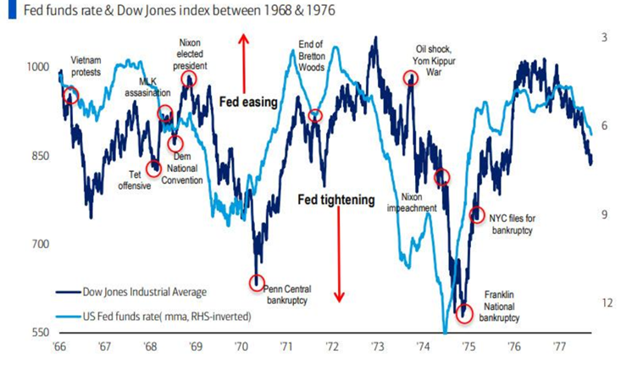
Feature Selection – 5 and 10 years yield

Slide 7
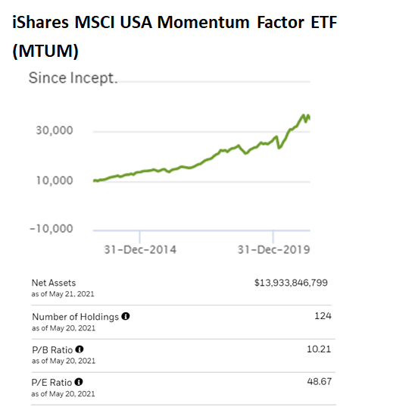
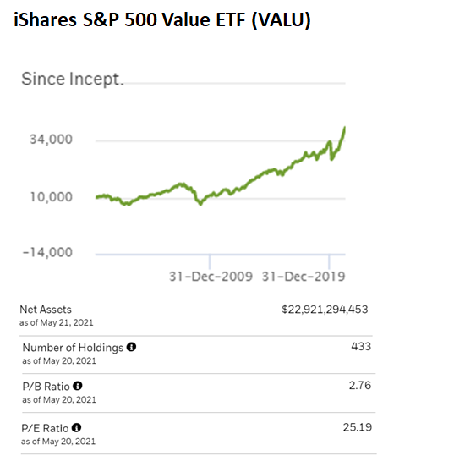
Feature Selection – MTUM and VALU

Slide 8
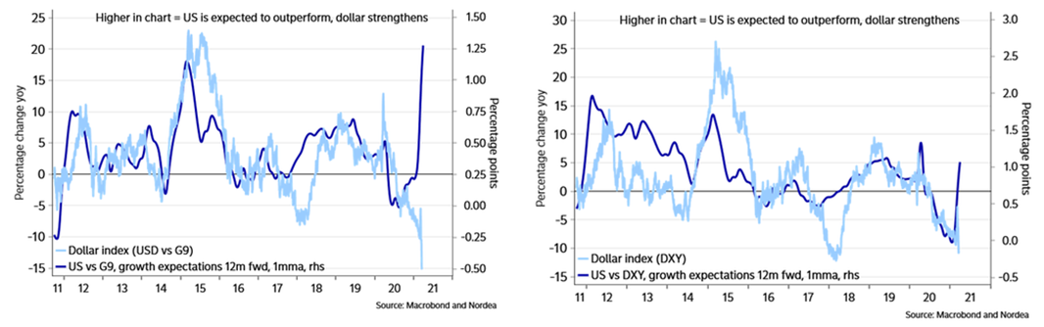
Feature Selection – DXY

Slide 9
Pre-trade Analysis

Slide 10
https://elec7080.herokuapp.com/
Infographic Style
Six Aspects of Pre-trade Analysis
Macroeconomics
Market
Technical
Fundamentals
News
Analysts/ KOLs

Slide 11
Prediction Model
BUY
SELL

Slide 12
Prediction Model
Regression Models
Linear Regression
Core Idea
Pros:
Easy to explain, know the data better
Efficient in training and fine tune
Kernel Regression
Use Prediction Model to acquire predicted next day’s return
Give suggestions on the parameters
Robust Regression
Cons:
Limited performance
More suitable for data with linear relationship
Train
Validation
Test
Train model
Select stocks
Trading signal
Back-testing

Slide 13
Long-short Strategy

Slide 14
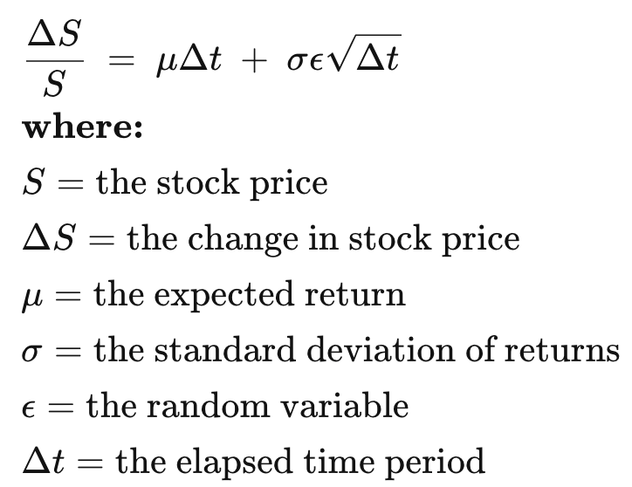
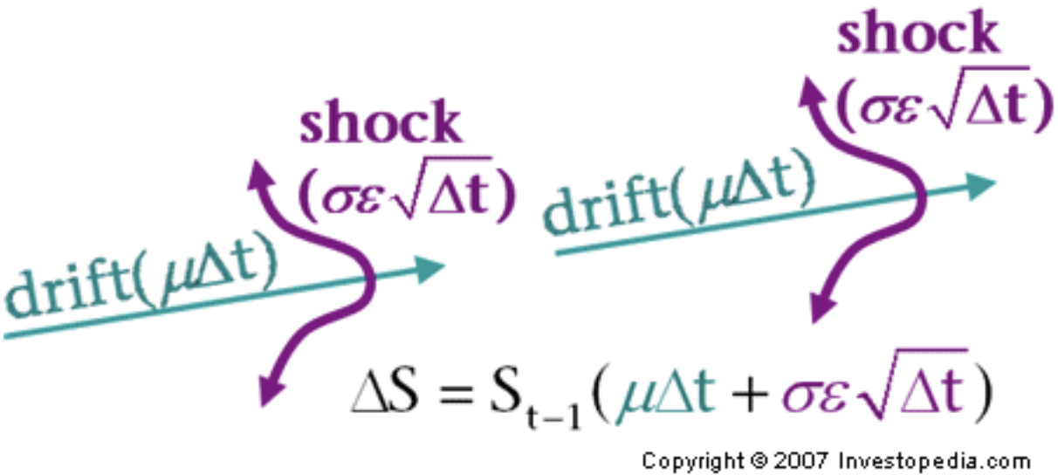
Long-short Strategy
Stock Selection Criteria
Trading Signal
Predicted return rate
Predicted result of the validation set
Everyday
Obeys standard normal distribution
MAE
Predicted return rate standard deviation
MSE
Criteria
STD
Expectation of predicted return rate

Slide 15
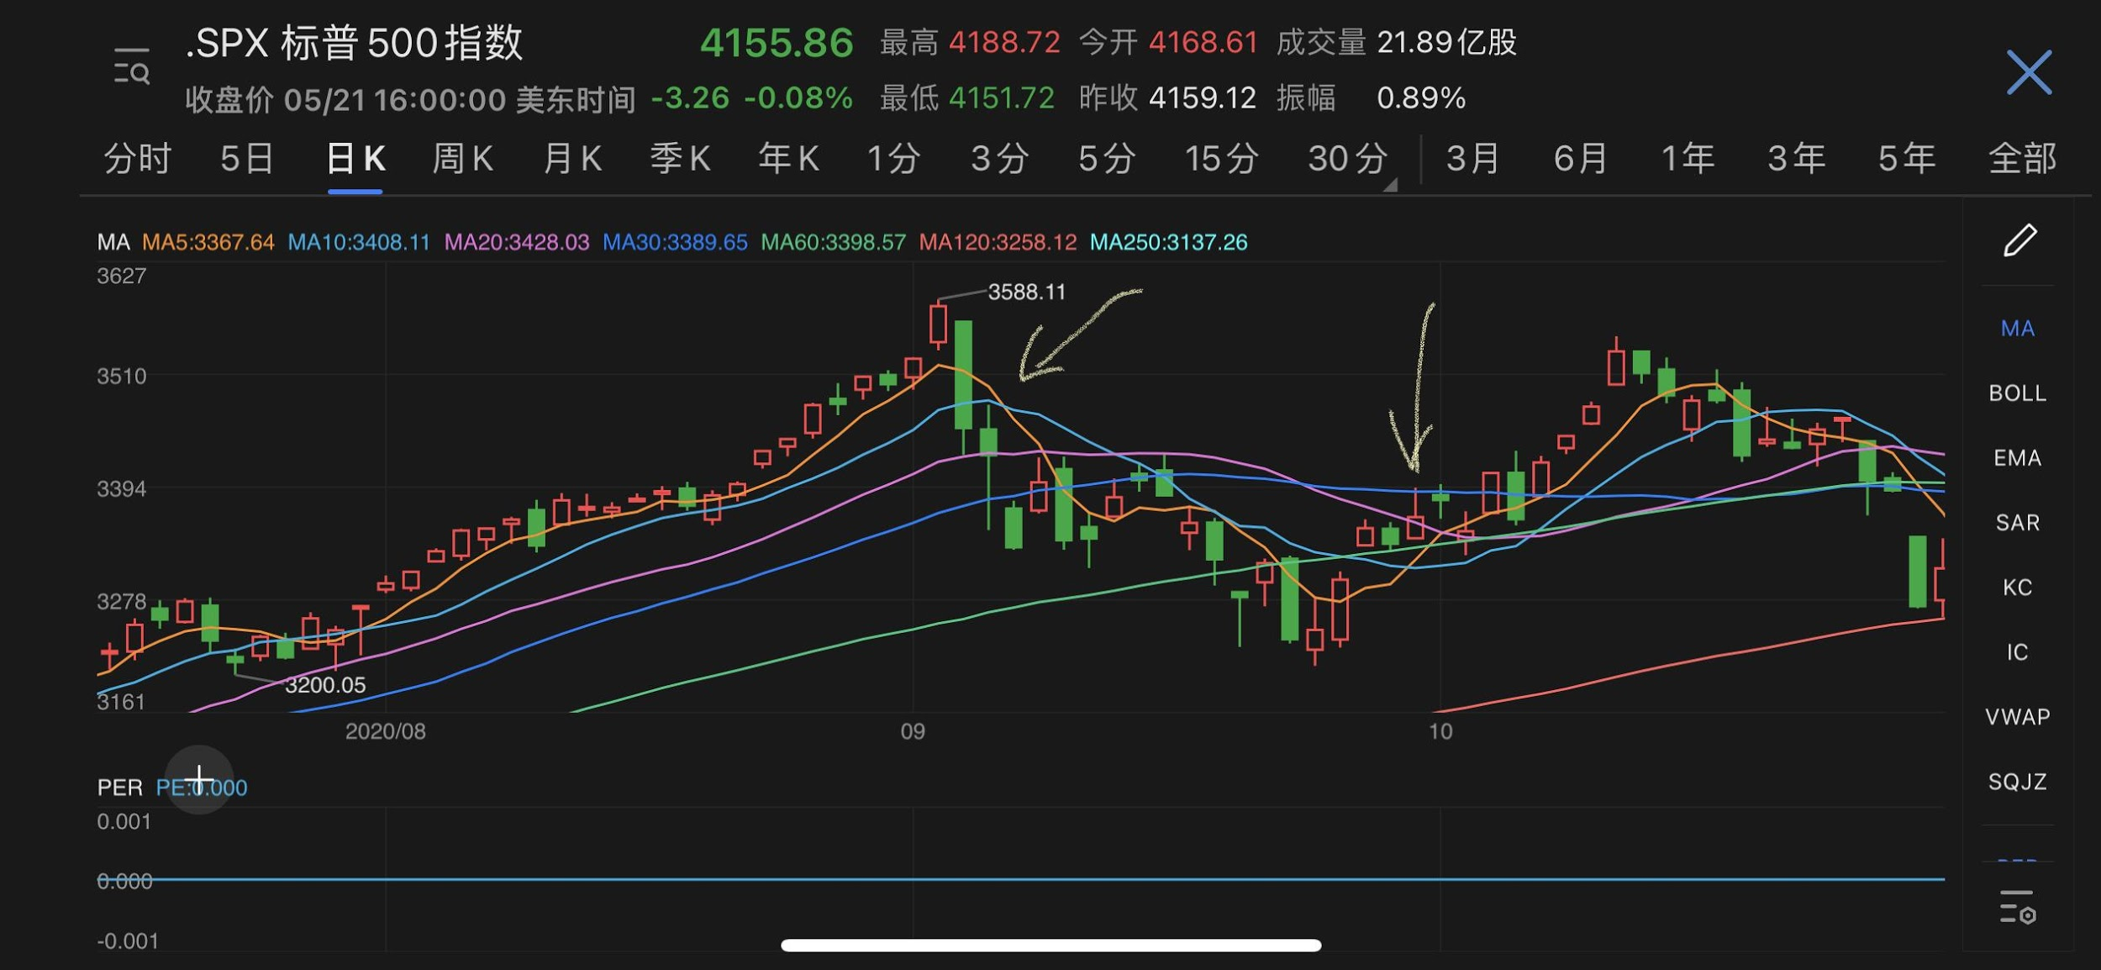
Long-short Strategy
Decide Market Trend
1
2
The “1” is a black crossing. Thus, we regard it as a bearish signal.
The “2” is a golden crossing. Thus, we regard it as a bullish signal.

Slide 16
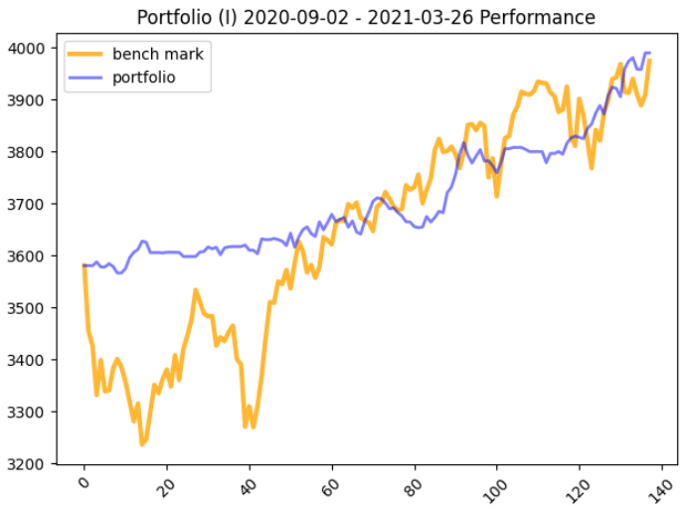
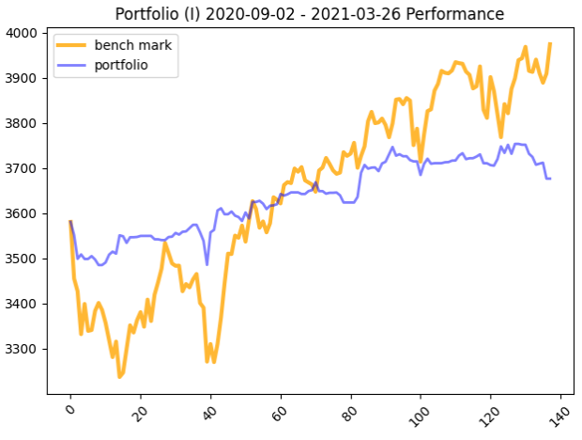
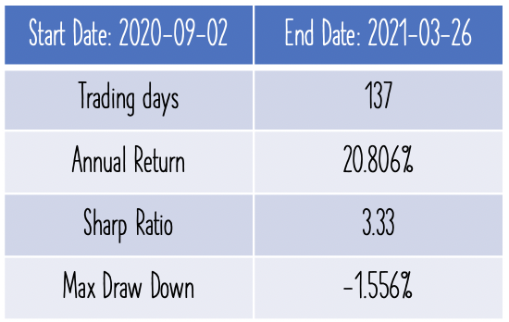
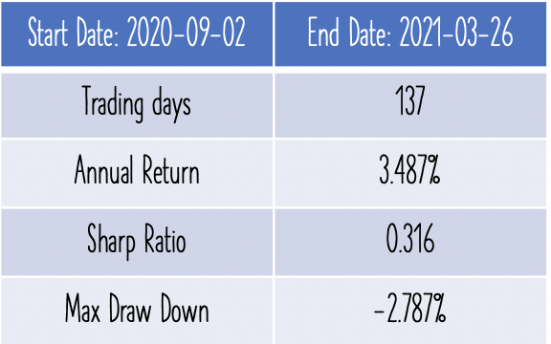
Long-short Strategy
Strategy Construction
Reduce Volatility
Stop Loss & Take Profit Point
Trade at Next Day’s Adequate Price
Daily Bases
Transaction Cost
Kernel Model
Robust Regression

Slide 17
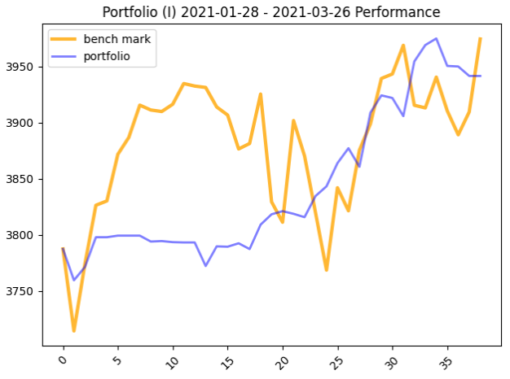
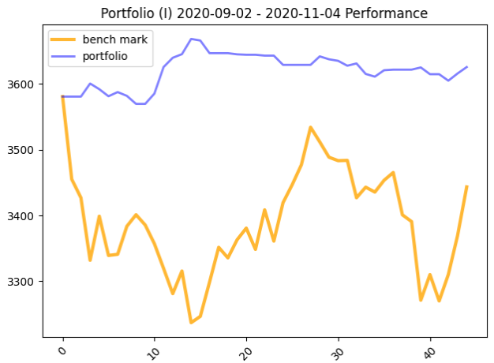
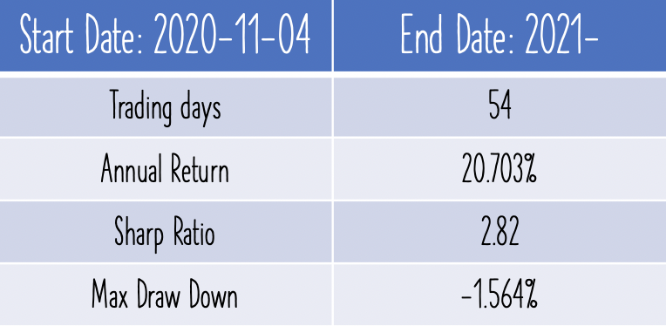
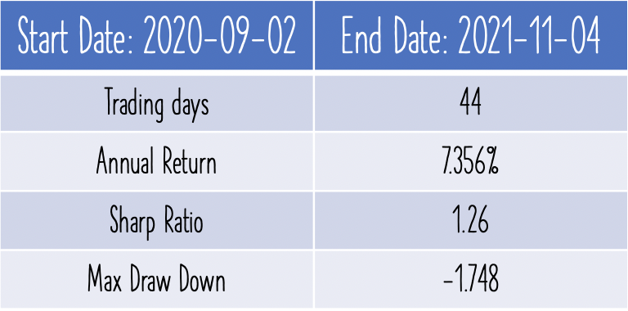
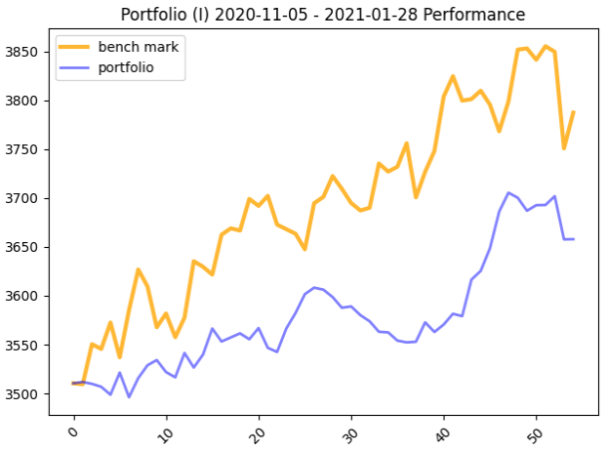
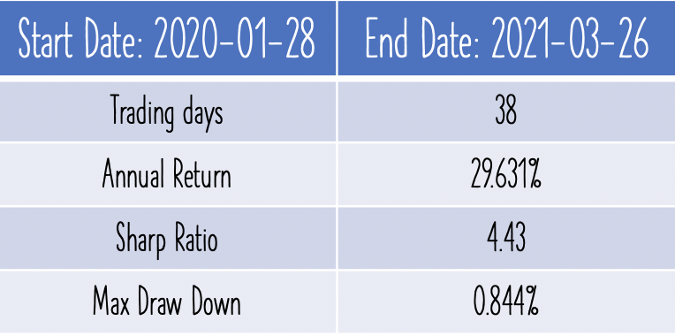
Long-short Strategy
Back-testing: Different Time Period

Slide 18
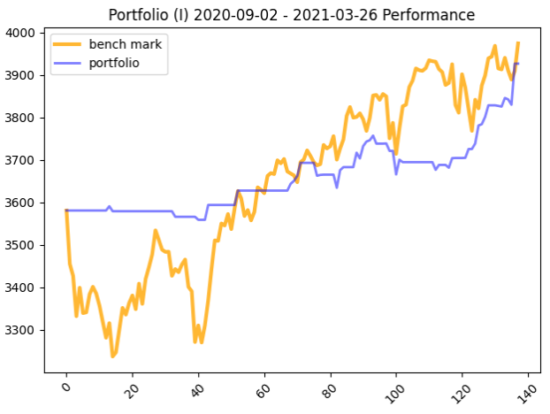
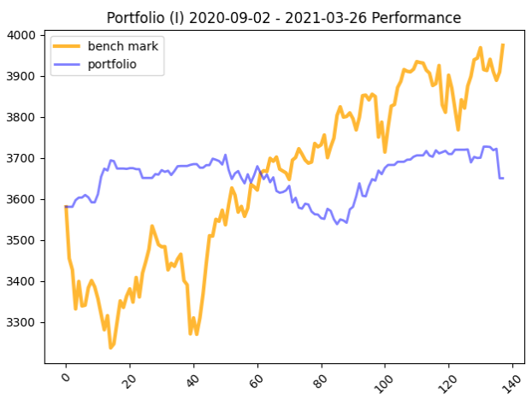
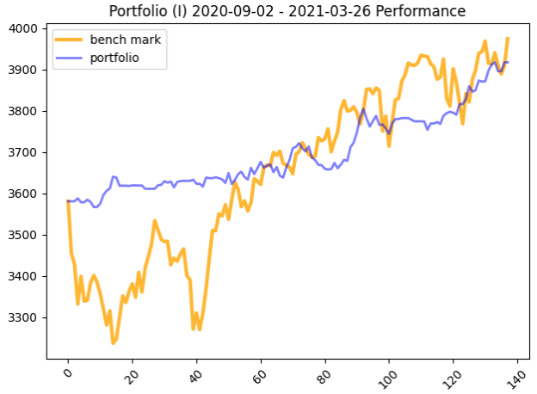
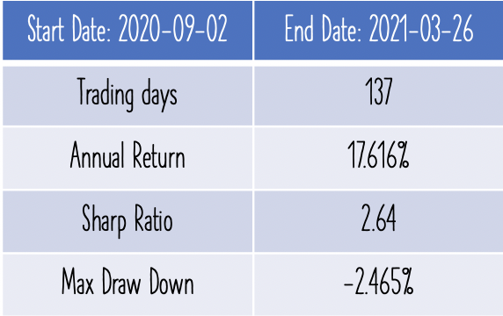
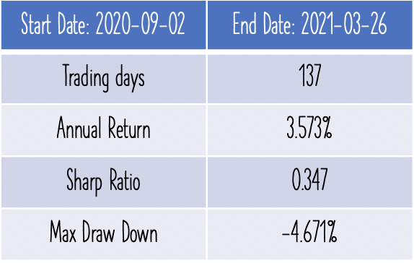
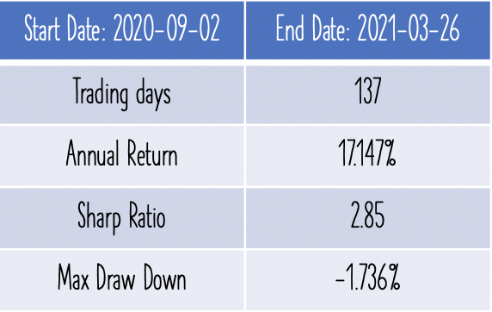
Long-short Strategy
Back-testing: Different Long Short Position Rate
Pure Long
Pure Short
Combination

Slide 19
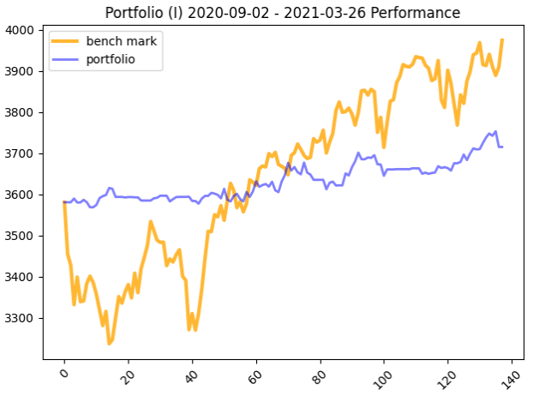
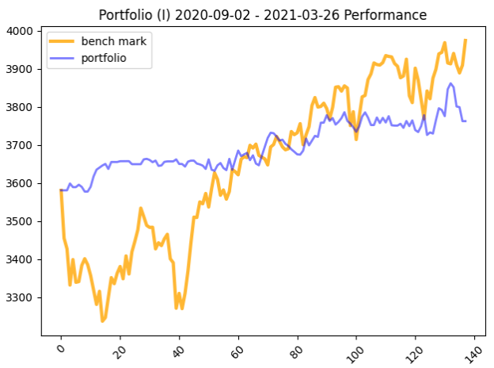
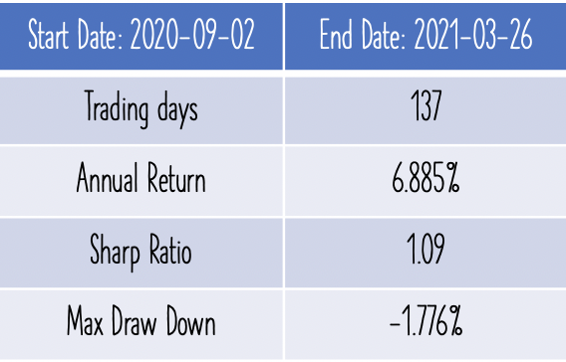
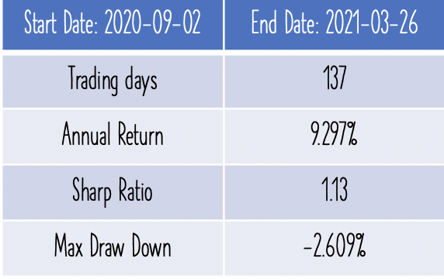
Long-short Strategy
Back-testing: Different Aggressiveness
Neutral
Aggressive

Slide 20
Risk Management
& Potential Improvement

Slide 21
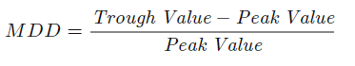
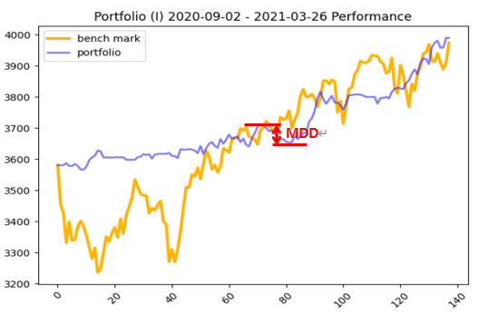
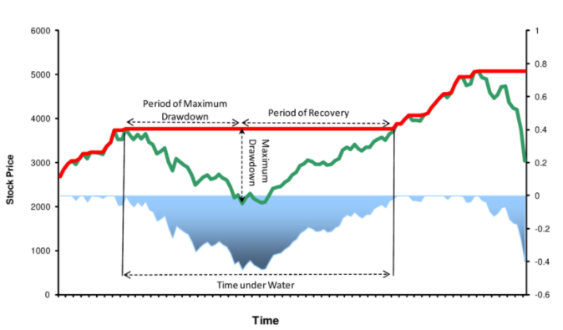
Risk Management
Maximum Drawdown = -1.56%

Slide 22
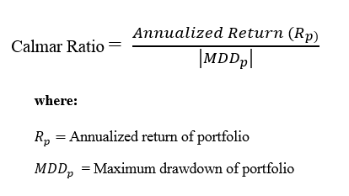
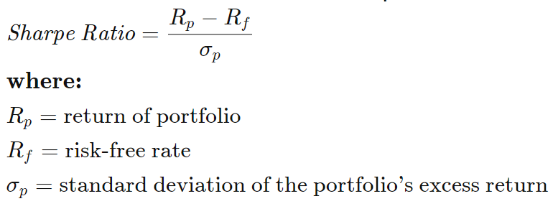
Risk Management
Sharpe Ratio = 3.33 Calmar Ratio = 13.3

Slide 23
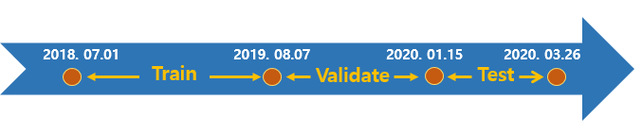
Potential Improvements
Use better quality intraday data i.e. data in minutes, seconds
Develop intraday algo trading strategies based on different benchmark
Hedging with different financial products - futures, options
Rolling basis training, validating, testing

Slide 24

Thank You

